Slide 1
Updates for Sam 2

Slide 2
TASKS
Clearly saw the spread of the points is in line with the

Slide 3
Preprocessing
Took out all points between midnight and 6AM and 8PM to midnight each day.
Saved file as preprocessed_data.json in the Github
Not too different plots so I ignored and explored other methods.

Slide 4
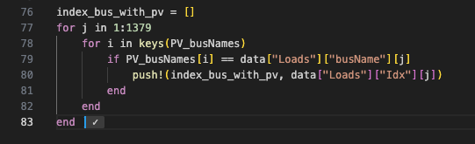
Three instances
No PV – bus 2
PV with Volt-Var – bus 1
PV with PF control – bus 8

Slide 5
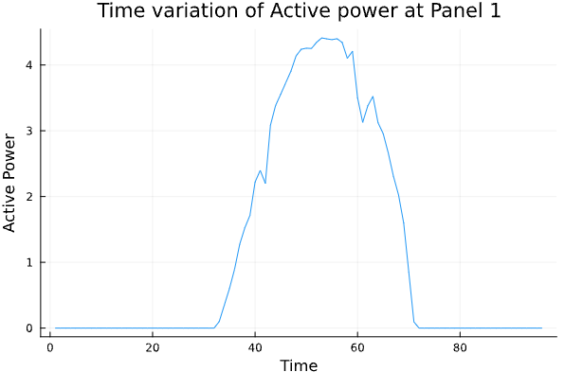
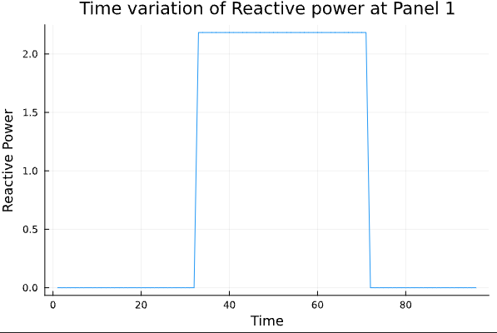
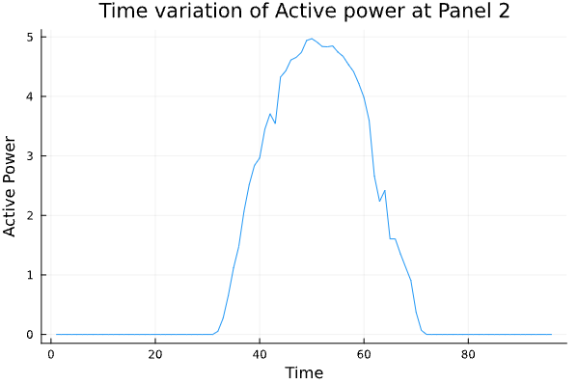
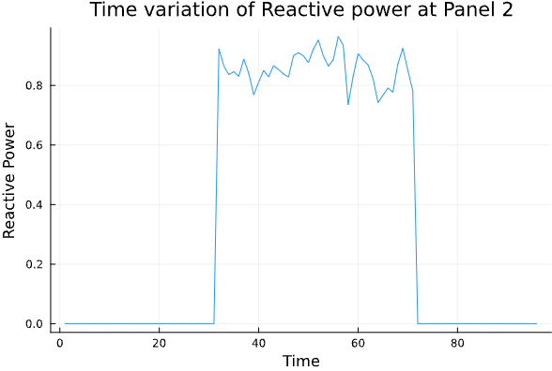
Visual representations of PV power
Plot as time varying to identify patterns

Slide 6
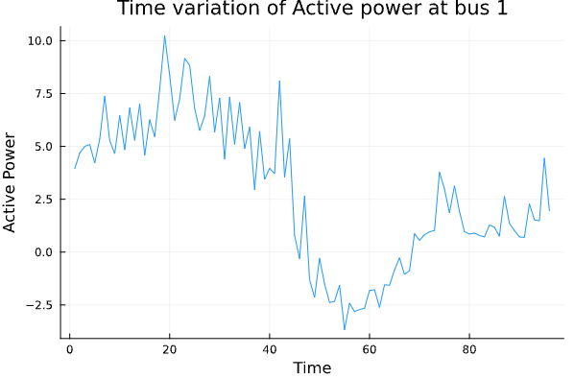
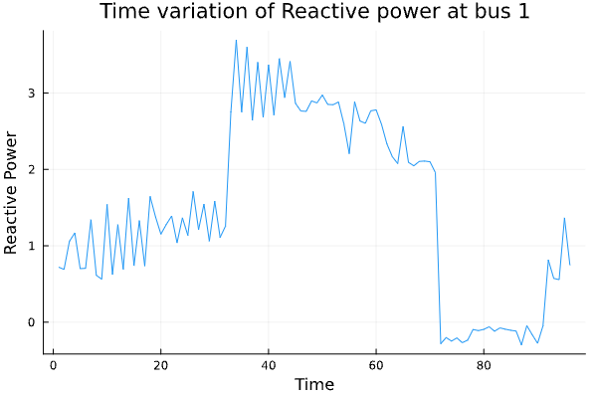
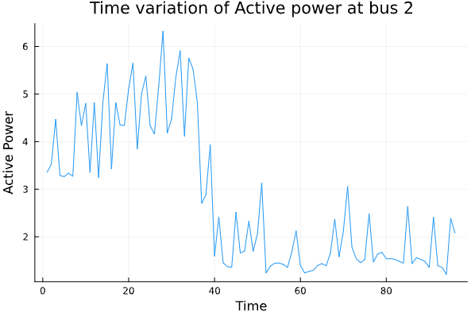
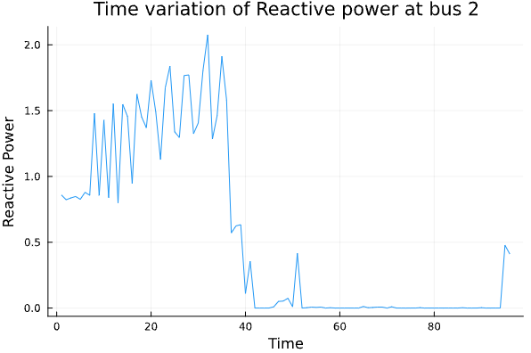
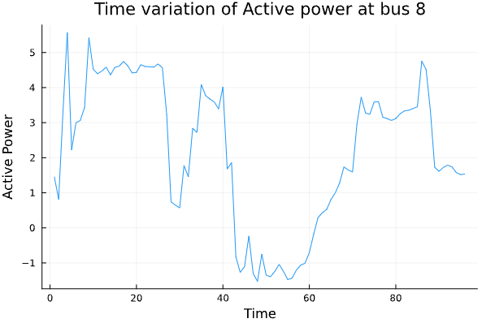
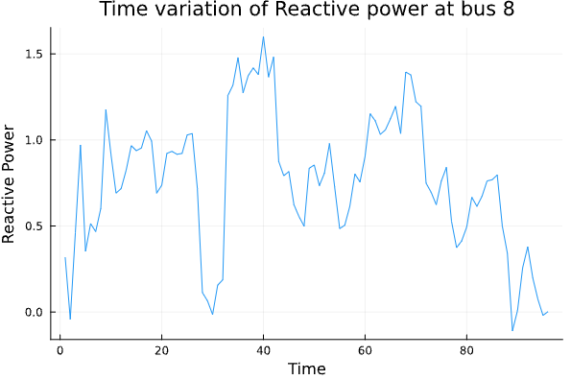
Visual representations of bus power
Plot as time varying to identify patterns
I see no real patterns. What about using PF calculations to see whether we can a trend?

Slide 7
PF ANALYSIS
Bus 1
Max PF – 0.9994
Min PF – -0.8568
Bus 2
Max PF -0.9999
Min PF – 0.9435
Bus 8
Max PF – 0.999
Min PF – -0.9503
Negative values indicative of presence of PV but is that defining enough?
Range in bus 2 too broad? I expected a narrower range.

Slide 8
Machine Learning approach
Since no clear and obvious trend is being noticed in the data, I considering an ML inspired method.
Classification neural network with P, Q and V as input and reactive control method as output.
35040 time steps as input to this model should be enough to train. Test on the other nodes.
More likely to learn patterns and predict accurately.

